Slide 1
How To Gather Requirements

Slide 2
Goals for Requirements
Understand the User's needs
Define the system
Manage Scope and Manage Change
  If we do the requirements correctly... this is much easier.
Refine the system definition
Build the right system

Slide 3
What is a requirement?
Your 336 books said:
  Pressman (Software Engineering a Practitioners Approach)
    A goal or objective your software must meet.
  Rosenberg (Use Case Driven Object Modeling with UML)
    A requirement describes a law that describes behavior.

Slide 4
What is a Requirement
Rational tends to use this one:
  Dorfman and Thayer (Standards, Guidelines, and Examples of System and Software Requirements) :
    a software capability needed by the user to solve a problem that will achieve an objective, or
    a software capability that must be met or possessed by a system or system component to satisfy a contract, standard, specification or other formally imposed documentation.

Slide 5
What is a requirement
I would tend to say:
  A goal for your project that you can check off your list when you are done.
  OR
  Requirements specify what the product should do not how you are going to do it.
    The how only becomes a requirement when your shop has particular required development tools.

Slide 6
Characteristics of Requirements
Correct – Does it do what your USER needs?
Verifiable – Can you create a unit test case for this requirement?
  Or said another way, requirements are as unambiguous as possible. If another programmer with similar skills were to pick up your project could they meet your requirements?

Slide 7
Characteristics of Requirements
Traceable - The ability to determine for each requirement which parts of the systems architecture, design and implementation were created to satisfy that requirement or visa versa.¹
  Numbered - Every requirement has a unique number so that it can be identified, discussed, tracked, and managed as a separate element of the project
¹ McConnell, pg 279

Slide 8
Hum?
Do you like these requirements?
  The system shall provide an easy-to-use graphical user interface based on MS Windows 95
  Certified users shall have complete access to the blooper database.
  Be able to create, edit and delete a zerbert.
  Request and validate Credit Card Information
  Be able to create a new actor.

Slide 9
What’s so difficult?
The most difficult part of requirements gathering is not the act of recording what the users want; it is the exploratory, developmental activity of helping users figure out what they want.
Steve McConnell (pg 114)

Slide 10
McConnell’s Process
Identify key users
Interview users to create a preliminary set of requirements.
Create a simple, interactive prototype
Show the end users the prototype and refine.
Loop between steps 3 and 4 until you’ve got it.
Write user documentation from the prototype. Baseline it. These are the user requirements.
Write a separate non-user based requirements document.
Talking Points:
  What advantages are there to this process?
  What disadvantages?
  What does step 1 assume? What does step 6 assume?

Slide 11
What's your metaphor?
A negotiator?
  Read "Getting to Yes"
A reporter trying to get all the information to write a story?
  You ask who, what, when, where, why
  You search out the root cause.
A cultural Anthropologist trying to understand their environment / culture?

Slide 12
Whatever the metaphor
You have to have some level of detachment.
  Ury calls this separating the people from the problem.
You have to treat your customer with respect.
  This means... they are are the expert... not you. (Otherwise why are you talking to them in the first place?)
  There is nothing more powerful then being listened to. Even if you can't do what the customer would like if you've listened to them, you have chips in the bank.

Slide 13
Interviewing End-Users
The section comes from pgs 253 – 255 of the Fifth Discipline Fieldbook.
The Fifth Discipline Fieldbook: Strategies and Tools for Building a Learning Organization. Peter M. Senge et all. Currency/Doubleday.

Slide 14
High
Telling
Asserting
Explaining
Dictating (dysfunctional)
Generating
Skillful discussion
Dialogue
Politicking (dysfunctional)
Advocacy
Low
High
Inquiry
Bystanding
Sensing
Withdrawing (dysfunctional)
Asking
Clarifying
Interviewing
Interrogating (dysfunctional)
Low
Inquiry

Slide 15
Inquiry
Bystanding - Making comments which pertain to the group process, but not to content.
Sensing – Watching the conversation flow without saying much, but keenly aware of all that transpires
Withdrawing (dysfunctional) – Mentally checking out of the room and not paying attention.

Slide 16
Asking
Clarifying – What is the question we are trying to answer?
Interviewing – Exploring others points of views and the reasons behind them.
Interrogating (dysfunctional) – Why can't you see that your point of view is wrong?

Slide 17
Telling
Asserting – Here's what I say and here's why I say it.
Explaining – Here's how the world works and why I can see it that way.
Dictating (dysfunctional) – Here's what I say and never mind why.

Slide 18
Generating
Skillful discussion – Balancing Advocacy and inquiry, genuinely curious, makes reasoning explicit, asks others about assumptions without being critical or accusing.
Dialogue – Suspending all assumptions, creating a container in which collective thinking can emerge.
Politicking (dysfunctional) – Giving the impression of balancing advocacy and inquiry while being close-minded.

Slide 19
The Metaphors
Cultural Anthropologist – Uses "Sensing", "Interviewing" and occasionally "Clarifying".
Journalist – Uses "Interviewing", "Clarifying" and when they go undercover, "Sensing".
Win-Win Negotiator – Uses "Skillful discussions" and "Dialog".

Slide 20
The Senge Prescription
Balance Inquiry and Advocacy.

Slide 21
Here is what I think
Stay out of the "Telling" Quadrant.
The "Asking" Quadrants are useful when you don't yet have a relationship with the client.
With new clients, start with the "Inquiry" or "Asking" Quadrants until you feel the client believes you understand her problems. Then move to the Generating Quadrants.

Slide 22
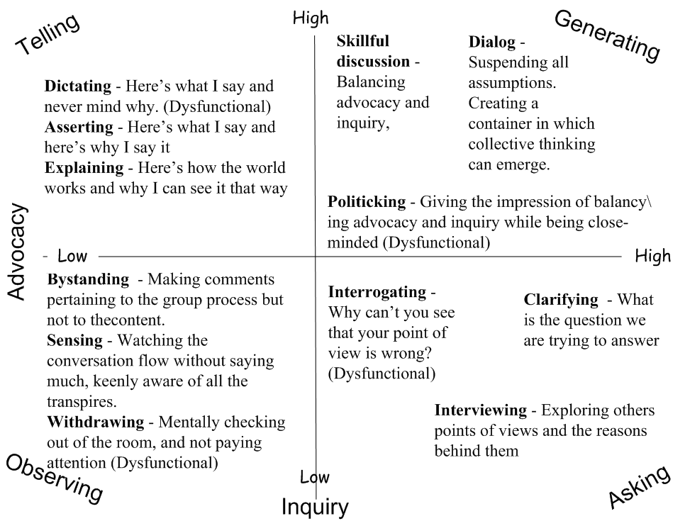

Slide 23
Curiosity
Here is some evidence that software engineers are different from their customers.
Meyers-BriggsType indicator ©.
  Developed by Katharine Cook Briggs and Isabel Myers.
  A way of describing the way people prefer to use their minds.
  Also called MBTI

Slide 24
MBTI
Four categories of preferences*
  Where, primarily, do you direct your energy?
    (Extroversion or Introversion )
  How do you prefer to process information?
    (Intuition or Sensing)
  How do you prefer to make decisions?
    (Thinking or Feeling)
  How do you prefer to organize your life?
    (Judging or Perceiving)
*Description Source “Working out your Myers Briggs type” http://www.teamtechnology.co.uk/tt/t-articl/mb-simpl.htm

Slide 25
The 16 Types*
ISTJ Inspectors (Queen Elizabeth) | ISFJ Protectors (Mother Teresa) | INFJ Mentors (Eleanor Roosevelt ) | INTJ Coordinators (Dwight Eisenhower)
ISTP Crafters (Clint Eastwood) | ISFP Composers (Barbara Streisand) | INFP Advocates (Albert Schweitzer ) | INTP Engineers (Albert Einstein)
ESTP Promoters (Madonna) | ESFP Performers (Elvis Presley) | ENFP Champions (Carl Rogers) | ENTP Inventors (Walt Disney)
ESTJ Supervisors (Colin Powell) | ESFJ Providers (George Washington) | ENFJ Teachers (Margaret Mead) | ENTJ Field Marshal (Bill Gates)
* The Four Temperaments. http://keirsey.com/matrix.html

Slide 26
Finance and Commerce Students*
ISTJ 9% | ISFJ 3% | INFJ .2% | INTJ 2.7%
ISTP 7.2% | ISFP 1.4% | INFP 2.3% | INTP 3.1%
ESTP 12.9% | ESFP 7% | ENFP 6.1% | ENTP 7.2%
ESTJ 21.7% | ESFJ 8.8% | ENFJ 1.6% | ENTJ 4.9%
* Source: Gifts Differing. Isabel Briggs Myers with Peter B. Myers. Page 42.

Slide 27
Engineering Students*
ISTJ 10.1% | ISFJ 4.2% | INFJ 5.3% | INTJ 13.8%
ISTP 2.2% | ISFP 1.9% | INFP 5.0% | INTP 8.7%
ESTP 3.1% | ESFP 1.3% | ENFP 5.7% | ENTP 7.3%
ESTJ 9.0% | ESFJ 3.3% | ENFJ 6.1% | ENTJ 13.0%
* Source: Gifts Differing. Isabel Briggs Myers with Peter B. Myers. Page 41.

Slide 28
Curiosity and Respect
In Full Circles, Overlapping Lives Mary Catherine Bateson argues that to know the "other" or the different we need to practice the interwoven disciplines of Curiosity and Respect.
If you can follow this discipline and ask questions... you will be much closer in your requirements.

